Slide 1
Implementing semantic segmentation

Slide 2

Load packages

Slide 3
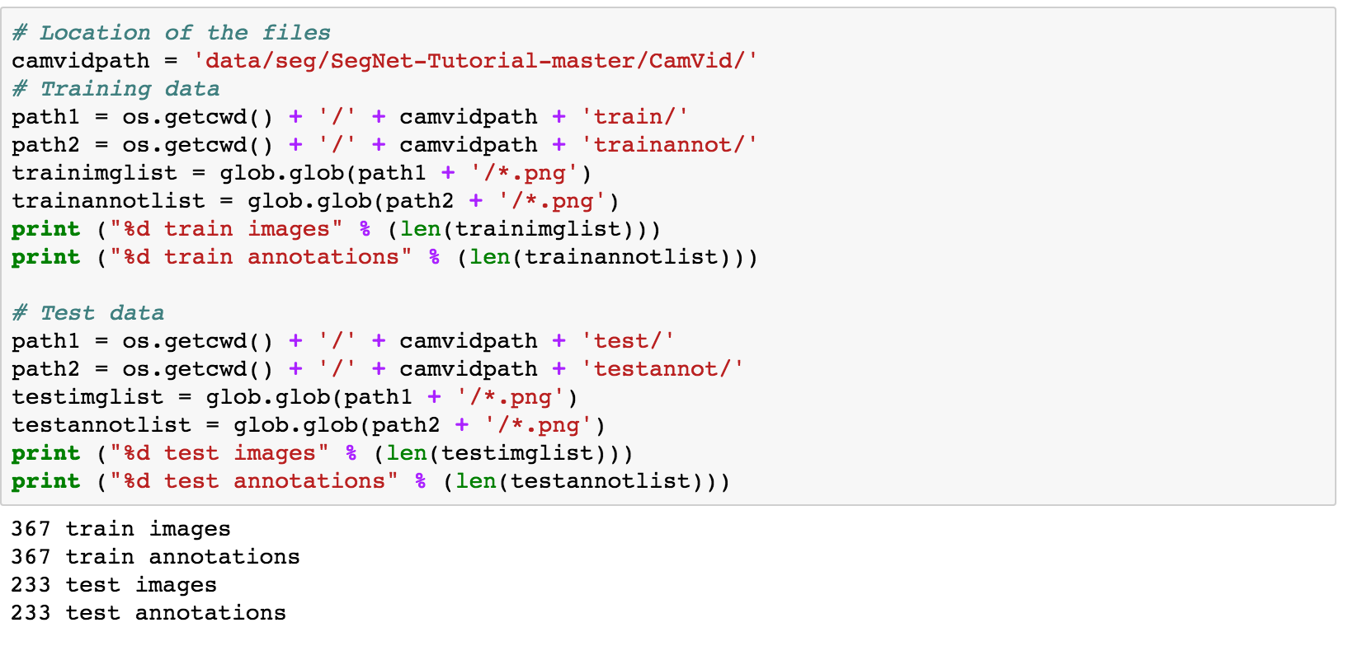
Load dataset

Slide 4
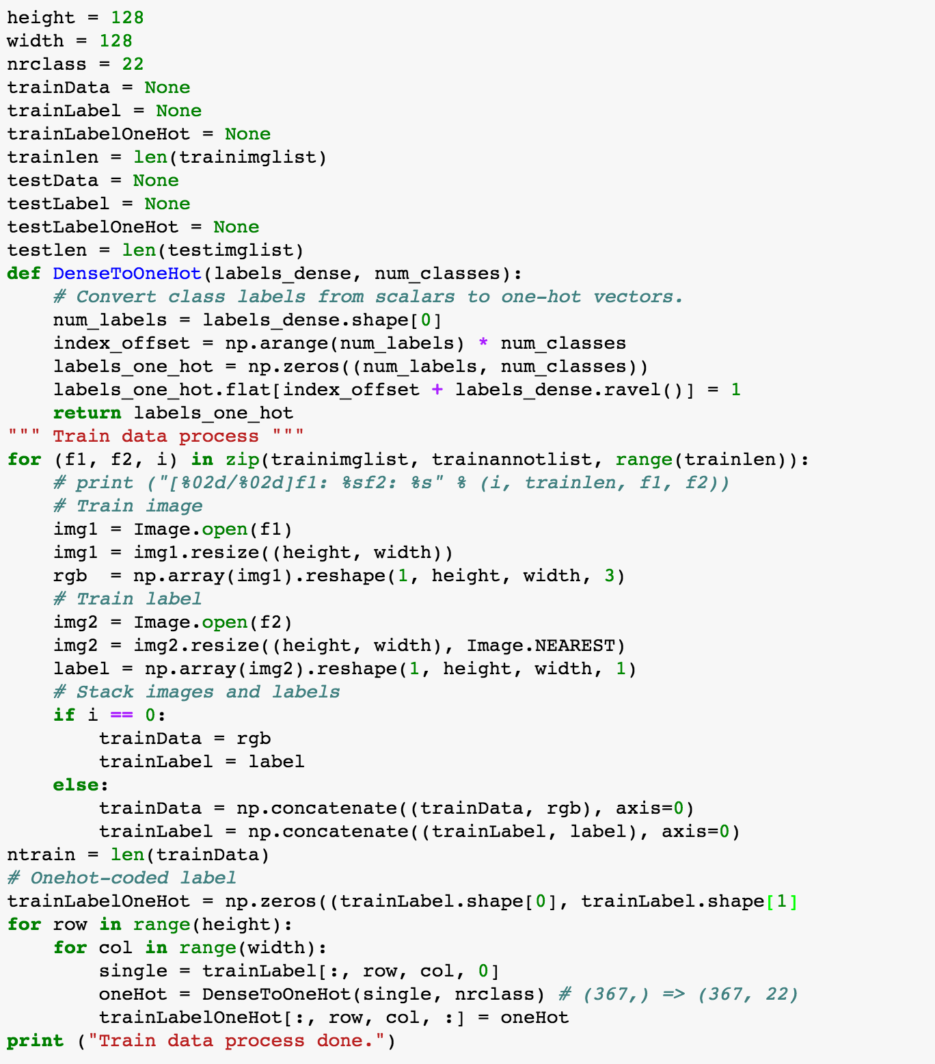

Slide 5

Shape of dataset

Slide 6
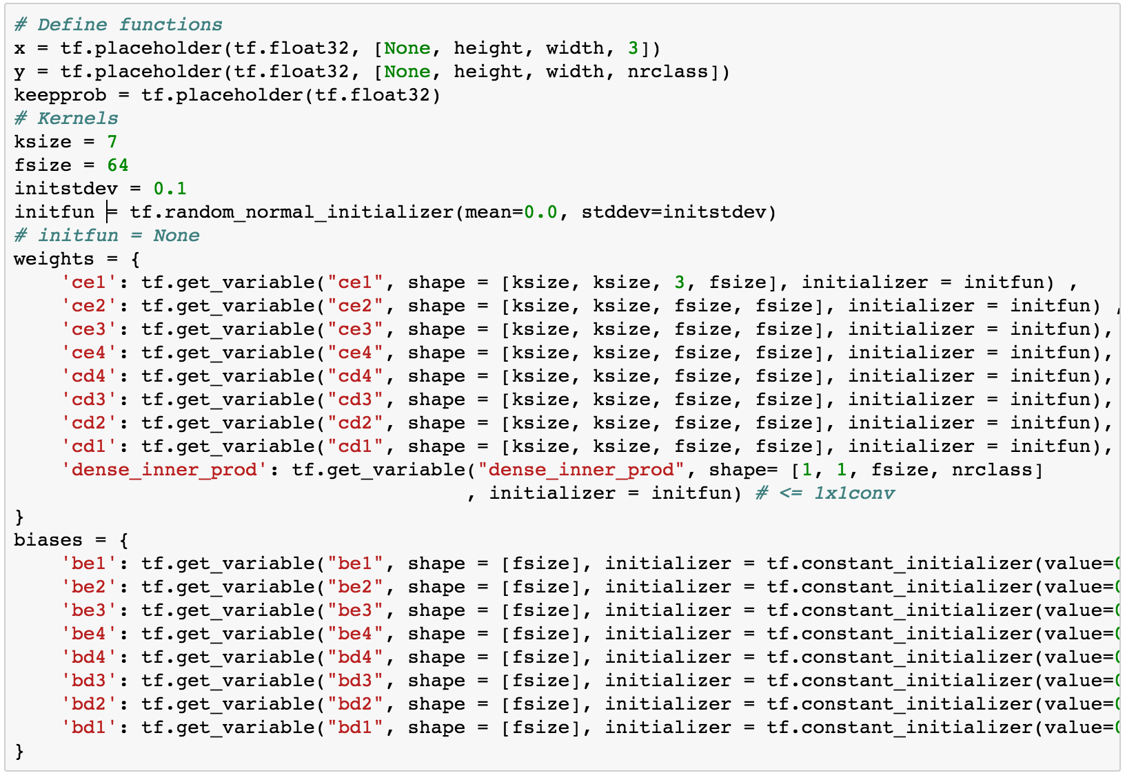
Network parameters

Slide 7
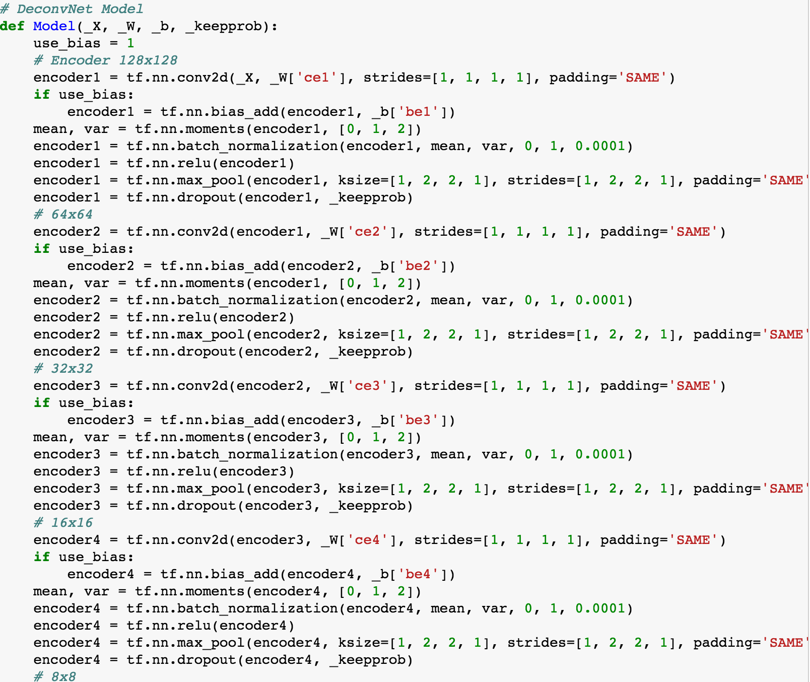
Model – encoding part

Slide 8
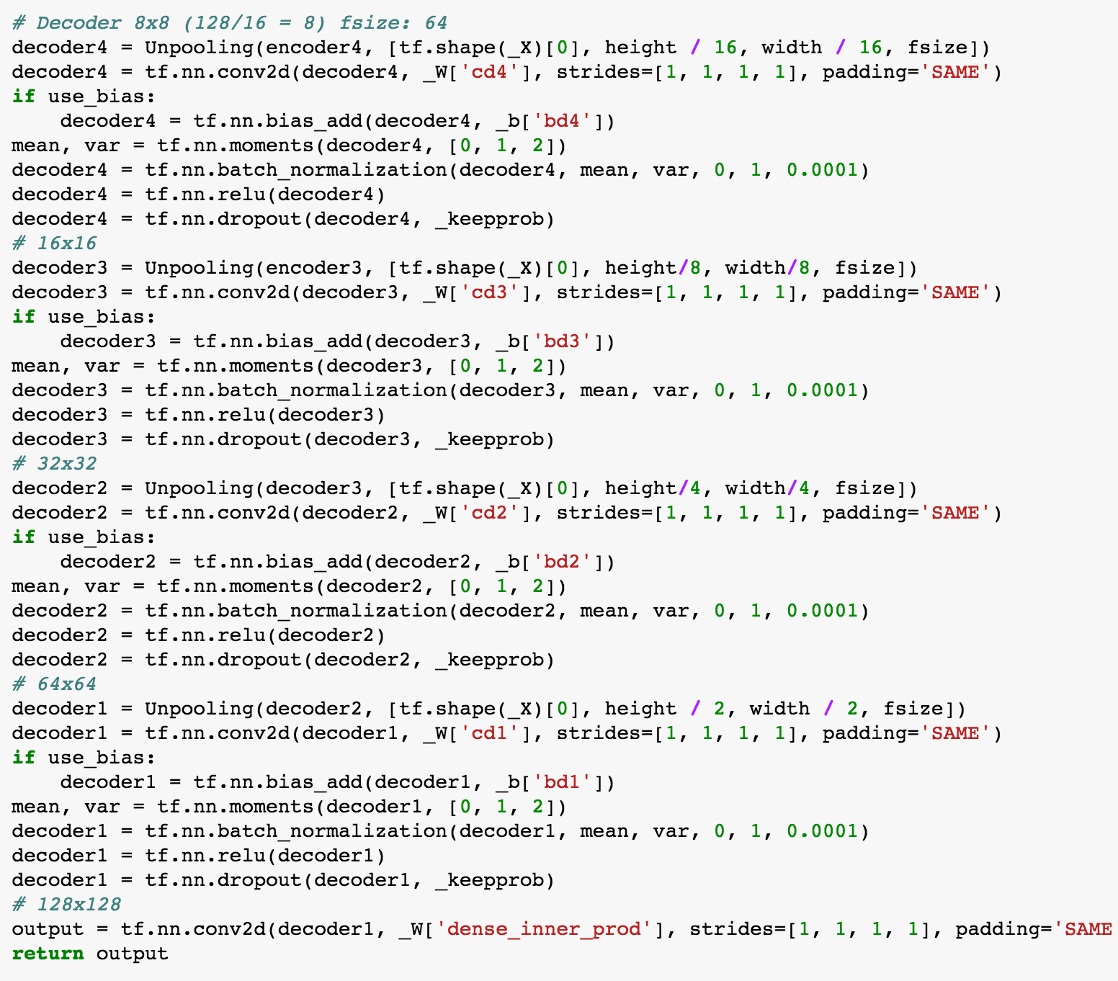
Model – decoding part

Slide 9
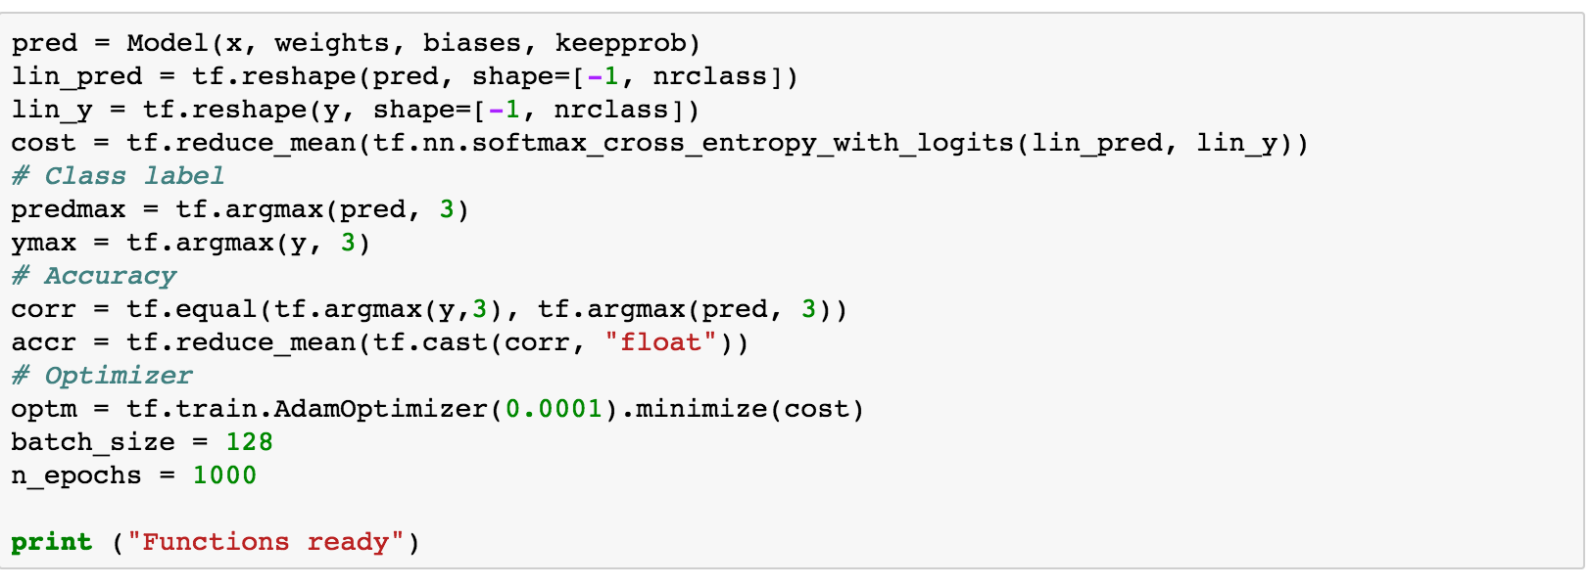
Define functions

Slide 10
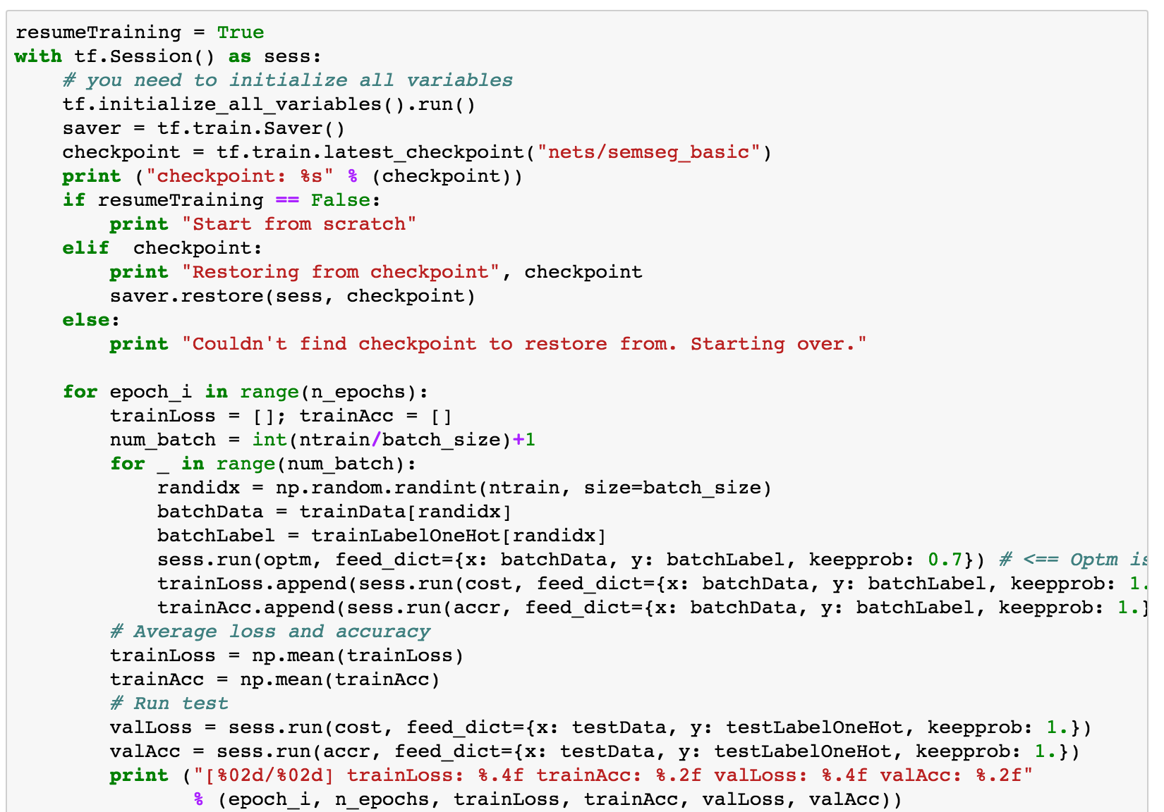
Optimization

